Slide 1

Tablet Rollout

Slide 2
We are excited to announce the successful completion of the test launch for our tabletop menu tablets at two Sauce & Spoon pilot locations.
This major milestone was reached through dedicated teamwork and cross-functional collaboration over the past month and a half.
The launch process included:
Sourcing and procuring tablets that met our technical and operational requirements
Working closely with internal teams, including Marketing and Head Chef Carter, to align on branding, menu integration, and kitchen coordination
Designing and delivering staff training programs at both locations to ensure comfort with the new system and deliver a seamless guest experience
This launch sets a strong foundation for evaluating success and planning the broader rollout.
Summary

Slide 3
Overview
Goals of the Tablet Pilot Test Run
With this test rollout, our key objectives were to:
Achieve faster service times, targeting an average ticket time of 8 minutes for appetizers and 12–15 minutes for entrées
Streamline the checkout process, aiming for a tablet checkout time of under one minute to enhance guest convenience
Minimize technical issues experienced by customers while using the tablets, ensuring a smoother digital experience
Reduce lobby wait times, with a goal of seating guests in under 10 minutes to improve guest flow and satisfaction

Slide 4
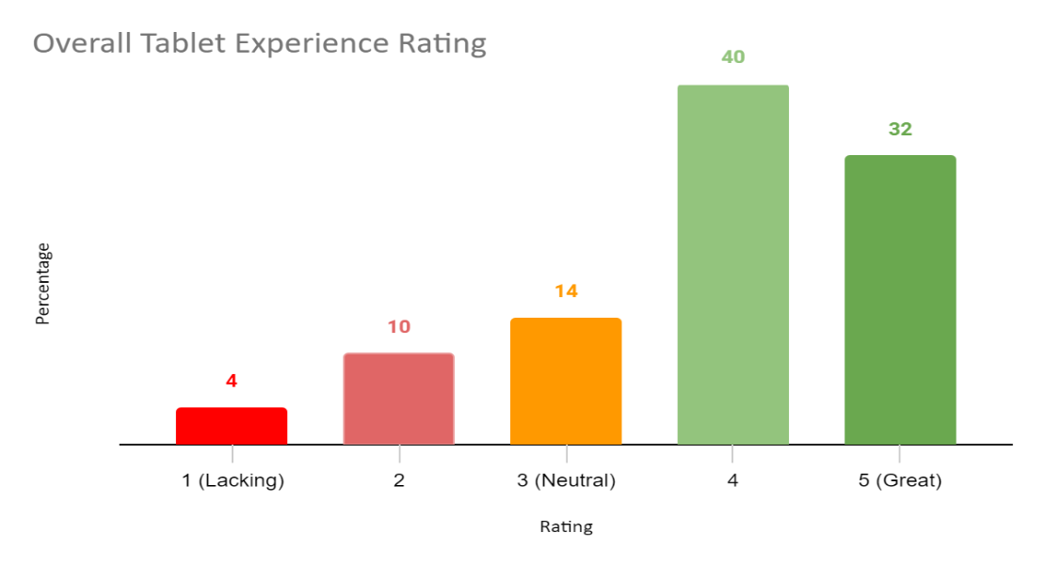
What worked?
86% of customers had a positive or neutral experience using the tablets.
82% received their food in less than 30 minutes.
86% reported the checkout process quick, easy, and secure.
Opportunities:
54% of customers had to wait over fifteen minutes for a table
Only 16% of customers signed up for the Birthday Club using the tablets
Findings

Slide 5
What Could Be Improved?
Reduce seating wait times by identifying why some guests wait over 15 minutes; analyze current table turn times and explore additional areas for improvement
Improve tablet usability by addressing guest feedback on interface and user experience; consider collaborating with marketing and providing input to the vendor for software enhancements
Offer guests the choice between using the tablet or interacting with a waiter, allowing for a more personalized dining experience
Explore guest preferences through continued surveys and feedback to better understand why some customers prefer waiter interaction, and adjust service accordingly
Next Steps

